Slide 1
Deep Learning Acceleration Hardware/Software Approaches
李哲榮

Slide 2
Deep Learning Acceleration
The training process is very time consuming, so is the inference
Different approaches to accelerate the process
Hardware
GPU
FPGA
Parallel/Distributed system
Software (Algorithm)
Convolution
Stochastic gradient descent
Parallelization

Slide 3
GPU

Slide 4
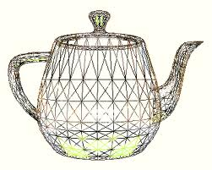

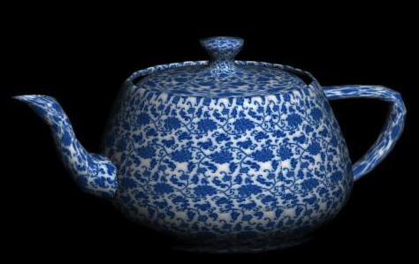
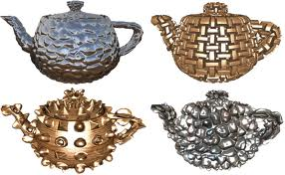
What is GPU?
Graphics Processing Unit (GPU) is a specialized chip designed for rapidly display and visualization.
The term was coined by Nvidia in 1999
The GeForce 256 as "the world's first 'GPU’.
Before 1987
1987-1992
1992-2000
Programmable GPU (after 2000)
General purpose GPU (after 2007)

Slide 5
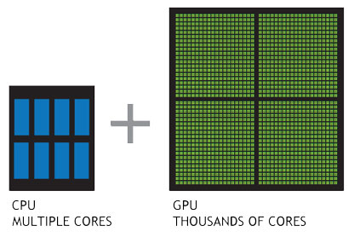
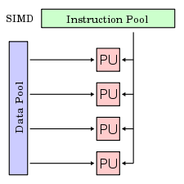
GPU programming model
A GPU has hundreds to thousands of cores. They can work in parallel.
Single Instruction Multiple Data (SIMD):
All computing nodes execute the same instructions on different data.
Each computing node has a unique ID to identify itself
Programmer needs to specify the mapping of computing nodes and the processing data.

Slide 6
GPU programming language
2000-2007: shader language
CUDA (Compute Unified Device Architecture)
A compiler and toolkit to program NVIDIA GPUs.
Extension of C/C++ programming language.
Express SIMD parallelism.
OpenCL (Open Computing Language)
A framework for writing programs that execute across heterogeneous platforms consisting of CPU, GPU, DSP, and other processors.
OpenACC
Using pragma to parallelize sequential code on acclerators

Slide 7
CUDA programming flow
① Copy data to GPU memory
Host
Device
CPU Memory
(DRAM)
GPU Memory
④ Copy result from GPU memory
CPU
GPU
② Call GPU functions
③ GPU executes program

Slide 8
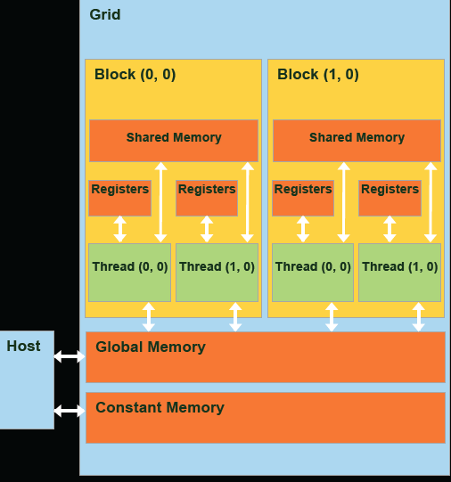
GPU memory hierarchy
Registers
Read/write per-thread
Shared memory/cache
Read/write per-block
Local memory
Read/write per-thread
Global memory
Read/write per-grid
Constant memory
Read only per-grid
(Local Memory)

Slide 9
General strategy
Load data from global memory to shared memory
Process data in the shared memory
Write data from shared memory to global memory
Thread blocks
Shared memory
Global memory

Slide 10
GPU performance optimization
GPU programming is easy(?), but performance optimization is hard.
Performance optimization is a circle, not a line.
APOD process
Access
Parallelize
Optimize
Deploy
Access
Parallelize
Optimize
Deploy

Slide 11
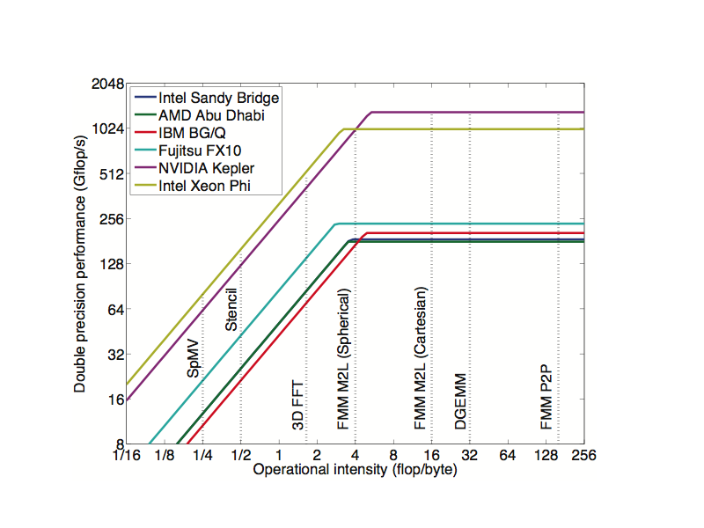
Roofline model

Slide 12
Communication vs computation
Peak performance for Kepler
The peak SP performance is 3935 Gflops.
The bandwidth is 250GB/s, which equals to 63G floating point data per second.
The ratio is about 60 times
Instruction execution
Each computation instruction takes 1~4 cycles
Each load/store instruction for global memory access takes 400~800 cycles
The ratio is about 100 times

Slide 13
Data pre-fetch and reuse
GPU has faster memory spaces (but smaller)
Shared memory / L1 cache
Register file
Prefetch data to shared memory or registers for later computation
However, those memory space is small
Reuse the data in shared memory or registers as many times as possible

Slide 14
Multitasking model
More (software) threads than (hardware) core
Even with the price of context switch…
Multitasking allows massive threads to cover the latency of communication/computation
If a thread is waiting for memory RW or computation dependency, other thread can fill in the idle time
Best scenario
All cores and memory bus are busy all the time.

Slide 15
Hardware consideration
To get the peak performance of data transfer, should take care of the hardware properties
Reduce the number of data transfers
Maximize the bandwidth usage
Maximize the shared memory/register usage
Memory transfer optimization
Memory coalescing
Bank conflicts avoidance
Occupancy: Register splitting

Slide 16
Computation to communication (CTC) ratio
Shared mem is like cache, but programmable
You can decide when and what data to put on it.
Useful only when data in the shared memory can be “reused”
Reusability can be estimated by the computation/ communication ratio

Slide 17
Example: matrix multiply
Compute C = AB, where A, B, C are N by N matrices
O(N²) data and O(N³) computation
For N > 64, the computation can hide the communication cost.
For i = 1:N
For j = 1:N
For k = 1:N
C[i][j]+=A[i][k]*B[k][j]

Slide 18
In reality
Suppose N=1024. The data are stored in 3N² matrices of integers or floats (12M)
To compute C[i][j], it needs 2N data A[i][*] and B[*][j], which are 2*1024*4 = 8 K.
Share memory is only 48K. So 6 C[i][j] can be computed.
The computation/communication ratio is 1.
If fixing i, we can reuse A[i][*].
The CTC ratio is about 2.

Slide 19
Can we do better?
If we have 12 vectors, we should be able to compute max {x*(12-x)} C[i][j].
The solution is x=6, and max {x*(12-x)}=36 C[i][j].
The computation/communication ratio is ~6.
Good, but not good enough.
We need CTC ratio >= 64.
B
A
C

Slide 20
Can we do better?
We can use half vectors to compute half C[i][j]
Which means we use A[i][1:512] and B[1:512][j] to compute a half C[i][j] and merge 2 results later.
By doing so, we can 12*12 = 144 half C[i][j].
The comp/comm ratio is 144N/12N = 12
How about quarter vectors?
If we use 1/8 vectors,
If we use 1/16 vectors,
B
A
C

Slide 21
Tiled algorithm
Such kind of algorithms are called block algorithms or tiled algorithms, since they splits the inputs into blocks (tiles) to fit into shared (cache) memory.
Larger CTC-ratio does not imply better performance.
CTC-ratio should be larger enough to high the communication cost, not the larger the better.

Slide 22
Coalesced memory access
Global memory loads and stores by threads of of a warp (32 threads) are coalesced by the device into as few as one transaction.
The concurrent accesses of the threads of a warp will coalesce into a number of transactions equal to the number of cache lines necessary to service all of the threads of the warp.

Slide 23
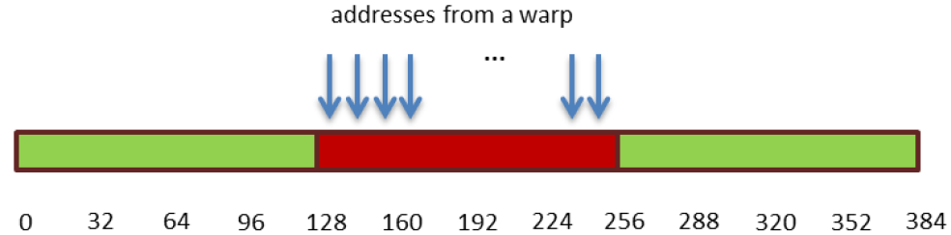
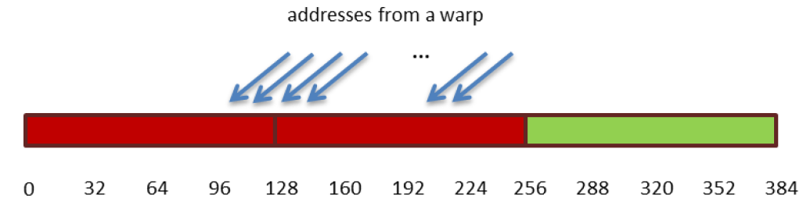
Example
Coalesced access
Unaligned sequential addresses that fit into two 128-byte L1-cache lines

Slide 24
Example: Square of numbers
Let A be an array of 16 element. Compute the square of their numbers.
Four threads
Thread 0 computes A[0] to A[3]
Thread 1 computes A[4] to A[7]
Thread 2 computes A[8] to A[11]
Thread 3 computes A[12] to A[15]

Slide 25
Coalescing access
Thread 0 computes A[0],A[4],A[8],A[12]
Thread 1 computes A[1],A[5],A[9],A[13]
Thread 2 computes A[2],A[6],A[10],A[14]
Thread 3 computes A[3],A[7],A[11],A[15]
Memory access can be coalesced

Slide 26
Example: Square numbers

Slide 27
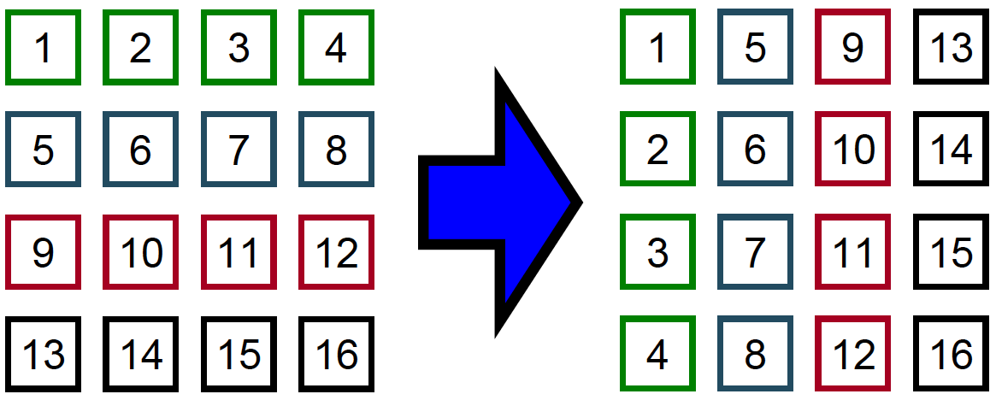
Example: Matrix transpose
SDK Sample (“transpose”)
Illustrates coalescing using shared memory
Speedups for even small matrices

Slide 28
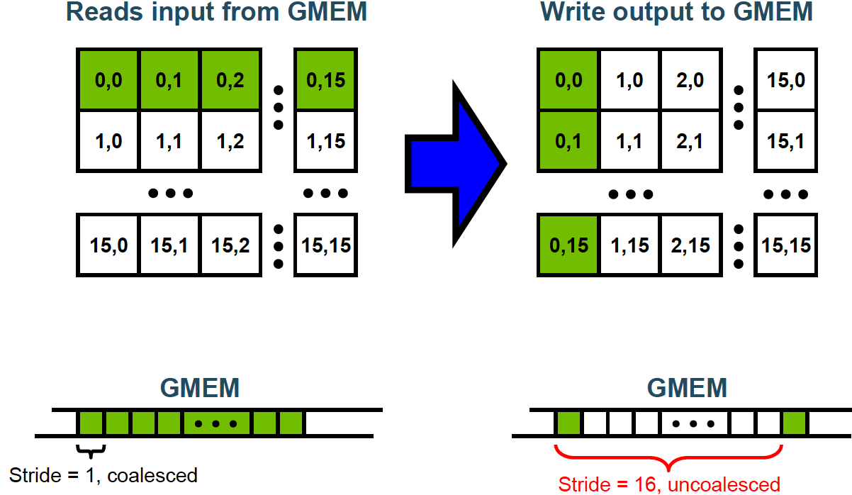
Uncoalesced transpose

Slide 29
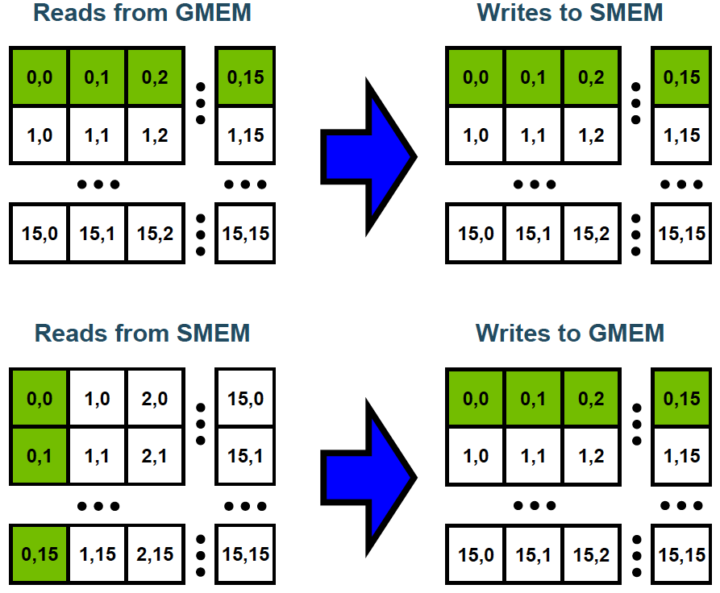
Coalesced transpose

Slide 30
FPGA

Slide 31
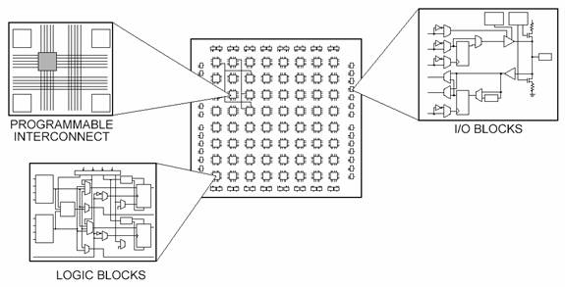
What is FPGA?
Field-programmable gate arrays (FPGAs) are reprogrammable chips.
FPGA has the same flexibility of software, but not limited by the number of CPUs.
FPGAs are truly parallel in nature, so different processing operations do not have to compete for the same resources.
FPGA often includes the number of configurable logic blocks, number of fixed function logic blocks such as multipliers, and size of memory resources like embedded block RAM.

Slide 32
Why FPGA helps DNN?
FPGAs can be used to implement the data and control path found in common logic functions, which is not a Von Neumann architecture.
FPGA are capable of exploiting distributed on-chip memory, as well as large degrees of pipeline parallelism, which fit naturally with the feed-forward nature deep learning methods.
Modern FPGAs also support partial dynamic reconfiguration, where part of the FPGA can be reprogrammed while another part is used.
FPGA architecture is tailored for the application, which allows more freedom to explore algorithm level optimizations.

Slide 33
Optimizing FPGA-based Accelerator Design for Deep Convolutional Neural Networks
Published in FPGA '15 Proceedings of the 2015 ACM/SIGDAP
FPGA: very suitable for latency-sensitive real-time inference job
Unmanned vehicle, Speech Recognition, Audio Surveillance, Multi-media
System architecture
External memory
On-chip memory (small)
Interconnect
Parallel processing elements (Pes)
Computation optimization and communication optimization

Slide 34
Computation optimization
Roofline model can help to identify the performance bottleneck
The higher CTC (computation to communication) Ratio the better performance.
Algorithm 2 is better than algorithm 1 because the roofline is computation.
Higher CTC ratio means move data to buffer once and reuse them as many times as possible.

Slide 35
Computation of convolution
N input feature maps; M output feature maps, whose sizes are RxC.
NxM Filters of size KxK
Sliding window size S
Code:
for(row=0; row<R; r++)
for(col=0; col<C; c++)
for(to=0; to<M; m++)
for(ti=0; ti<N; n++)
for(i=0; i<K; i++)
for(j=0; j<K; j++)
output_fm[to][row][col] += weights[to][ti][i][j]*input_fm[ti][S*row+i][S*col+j];

Slide 36
CNN configuration
The first 5 layers are convolutional layers and layers 6-8 form a fully connected artificial neural network.

Slide 37
Tiled algorithm
On-chip memory (buffer) is fast but relatively small
Partition the maps into tiles so that each tile can be fitted into buffer.
Goal: fully utilize the data in the buffers

Slide 38
Tile size selection
Given a specific tile size combination <Tm; Tn; Tr; Tc>, the computational performance (computational roof) can be calculated by,
Constrained by 0 < Tm*Tn < number of PEs; and 0 < Tm <= M; 0 < Tn <= N; 0 < Tr <= R; 0 < Tc <= C

Slide 39
Design space search

Slide 40
Different data sharing relations
Irrelevant: The loop iterator i does not appear in any access functions of an array A
Independent: The union of data space accessed on an array A is separable along a certain loop dimension i.
Dependent. The union of data space accessed on an array A is not separable along a certain loop dimension i.

Slide 41
Loop unroll and loop pipeline
Loop unroll for different data relations
Irrelevant Independent Dependent
Loop pipelining is a key optimization technique in high-level synthesis (HLS) to improve system throughput by overlapping the execution of operations from different loop iterations.

Slide 42
Code and generated hardware
High Level Synthesis (HLS) code

Slide 43
Memory optimization
Reduce memory movement between buffers and external memory
CTC Ratio where

Slide 44
Example: Local memory promotion
Do not move the output feature maps to buffers
The memory movement is reduced from to

Slide 45
Performance comparison to CPU

Slide 46
Power consumption comparison

Slide 47
Projected performance with tuning

Slide 48
Accelerated by lower precision

Slide 49
Floating point arithmetic
Current computer systems usually use floating point arithmetic
#include <stdio.h>
#define E_PI 3.1415926535897932384626433832795028841971693993751058209749445923078164062
int main(void) {
long double pild = E_PI;
double pid = pild;
float pif = pid;
printf("%s\n%1.80f\n%1.80f\n%1.80Lf\n",
"3.14159265358979323846264338327950288419716939937510582097494459230781640628620899",
pif, pid, pild);
return 0;
}
3.14159265358979323846264338327950288419716939937510582097494459230781640628620899
3.14159274101257324218750000000000000000000000000000000000000000000000000000000000
3.14159265358979311599796346854418516159057617187500000000000000000000000000000000
3.14159265358979311599796346854418516159057617187500000000000000000000000000000000

Slide 50
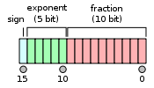
Computational influence
Operations of float are about 3 times faster than those of double.
On GPU and other CPU
Using float also benefit of storage and data communication
Float uses 4 bytes and double uses 8 bytes.
GPU also has Half precision (2 bytes)
ARM also supports half precision

Slide 51
Fixed point numbers
A fixed-point number representation is a real data type for a number that has a fixed number of digits after the radix point.
The radix point of floating point representation is floated
The representable range of fixed point is very limited
Cannot represent too large and too small numbers
But numbers in fixed point representation can be calculated very fast
Just like integer operations with fixed scaling
1
0
1
0
0
1

Slide 52
Precision influence for deep learning
Deep Learning with Limited Numerical Precision
https://arxiv.org/pdf/1502.02551.pdf
Deep neural networks can be trained using low-precision fixed point arithmetic, provided that the stochastic rounding scheme is applied while operating on (16 bits) fixed-point numbers.
WL: the total length of a number: WL = IL+FL
IL: the length of integer part
FL: the length of fraction part

Slide 53
Rounding
Round-to-nearest
Stochastic rounding: The probability of rounding x
to floor(x) is proportional to the proximity of x to floor(x):

Slide 54
MNIST dataset using fully connected DNN

Slide 55
MNIST dataset using CNNs:

Slide 56
High precision multiplication
High precision multiplication is major cost of hardware and performance

Slide 57
High precision accumulation
HARDWARE-ORIENTED APPROXIMATION OF CONVOLUTIONAL NEURAL NETWORKS

Slide 58
Dynamic fixed precision
When training deep neural networks,
Activations, gradients and parameters have very different ranges.
Gradients ranges slowly diminish during the training.
As a result, the fixed point format, with its unique shared fixed exponent, is ill-suited to deep learning.
The dynamic fixed point format (Williamson, 1991) is a variant of the fixed point format in which there are several scaling factors instead of a single global one. Those scaling factors are not fixed.

Slide 59
Convolution

Slide 60
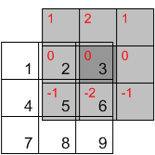

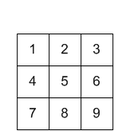
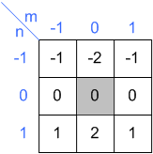

What is 2D convolution?
Input y
Input x
Filter h
http://www.songho.ca/dsp/convolution/convolution2d_example.html

Slide 61
High level program of 2D convolution
assume that we have a W*H image with depth D at each input location. For each location, we get a K*K patch, which could be considered as a K*K*D vector, and apply M filters to it.
for w in 1..W
for h in 1..H
for x in 1..K
for y in 1..K
for m in 1..M
for d in 1..D
output(w, h, m) += input(w+x, h+y, d) * filter(m, x, y, d)
https://github.com/Yangqing/caffe/wiki/Convolution-in-Caffe:-a-memo

Slide 62
How to optimize it?
Stack smaller filters to larger one
Using matrix-multiplication kernel
FFT (Fast-Fourier Transform)
Split filters
http://cs231n.github.io/

Slide 63
Stack smaller filters
Question: How big of a region in the input does a neuron on the second conv layer see?
Answer: 5x5
For 3 layers, the region is 7x7

Slide 64
Why stacked smaller filters are better
Suppose input is H x W x C and we use convolutions with C filters to preserve depth (stride 1, padding to preserve H, W)
For one CONV with 7 x 7 filters,
The number of weights is C x (7 x 7 x C) = 49 C².
The number of multiply-adds is (H x W x C) x (7 x 7 x C) = 49 HWC².
For three CONV with 3 x 3 filters,
The number of weights is 3 x C x (3 x 3 x C) = 27 C².
The number of multiply-adds is 3 x (H x W x C) x (3 x 3 x C)= 27 HWC².
Fewer parameters, more nonlinearity, so the latter one is better

Slide 65
Turn CONV to matrix multiplication

Slide 66

Slow motion of above slide
1 | 2 | 3 | 4 | 5 | 6 | 7 | 8 | 9
1
2
1
0
0
0
-1
-2
-1
Input x
Filter h

Slide 67
Implementing convolutions: FFT
Convolution Theorem: The convolution of f and g is equal to the elementwise product of their Fourier Transforms:
Using the Fast Fourier Transform, we can compute the Discrete Fourier transform of an N-dimensional vector in O(N log N) time (also extends to 2D images)

Slide 68
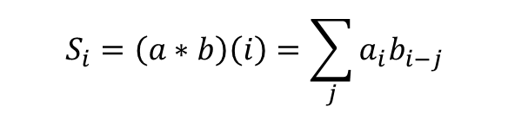
Slow motion of 1D CONV
Def of 1D conv
$$S_{i}=\left(a∗b\right)\left(i\right)=\sum_{j}{a_{i}b_{i−j}}$$

Slide 69
Separable filter
A 2D filter is separable if it can be expressed as a product of two vectors.
Suppose a pxq 2D filter .
The element of F equals to
-1 | 0 | 1
-2 | 0 | 2
-1 | 0 | 1
1
2
1
-1 | 0 | 1

Slide 70
Separable filters for CONV
If a 2D filter is separable, the 2D convolution can be computed via two 1D convolutions.
1D convolution of x and u

Slide 71
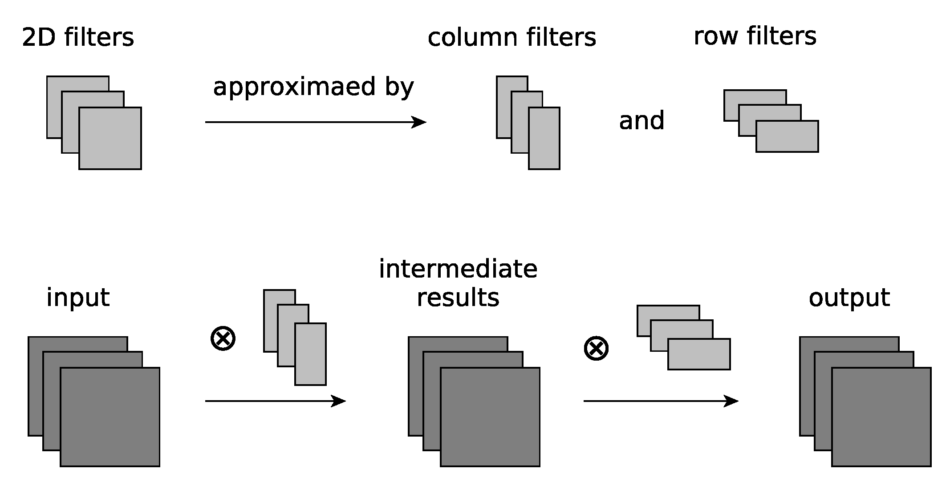
Algorithm

Slide 72
ImageNet Training in Minutes
https://arxiv.org/pdf/1709.05011.pdf

Slide 73
Introduction
Finishing 90- epoch ImageNet-1k training with ResNet-50 on a NVIDIA M40 GPU takes 14 days. This training requires 10¹⁸ single precision operations in total.
The world’s current fastest supercomputer can finish 2×10¹⁷ single precision operations per second (Dongarra et al. 2017).
It is possible to finish the 90-epoch ResNet-50 training in five seconds.
This paper presents a method to finish the training in minutes.

Slide 74
Data-Parallelism SGD
The dataset is partitioned into P parts, stored on each machine,
Each machine has a local copy of the neural network and the weights.
The communication includes two parts: sum of local gradients and broadcast of the global weight.
Each worker computes the local gradient independently, and sends the update to the master node.
The master then updates after it gets all the gradients from workers.
The master broadcasts global weight to all workers.

Slide 75
Challenges of scaling synchronous SGD
The first is giving each processor enough useful work to do
Larger batch size can give each processor more work to do
The second challenge is synchronization
This problem can be partially ameliorated by overlapping communication and communication.
Asynchronized SGD: The master node gives the current weight to worker, without synchrnozing all the workers

Slide 76
Large-Batch DNN Training
The larger batch size, the better speedup of GPU.

Slide 77
Large-Batch DNN Training

Slide 78
Difficulty of Large-Batch Training
Synchronous SGD with larger batch size usually achieves lower accuracy than when used with smaller batch sizes, if each is run for the same number of epochs, and currently there is no algorithm allowing us to effectively use very large batch sizes. (Keskar et al. 2016).
State-of-the-art approaches for large batch training include two techniques:
Linear Scaling (Krizhevsky 2014): If we increase the batch size from B to kB, we should also increase the learning rate from R to kR.
Warmup Scheme (Goyal et al. 2017): If we use a large learning rate R. We should start from a small R and increase it to the large R in the first few epochs.

Slide 79
Layer-wise Adaptive Rate Scaling (LARS)
The ratio the L2-norm of weights and gradients ||w||/||∇L(wt)|| varies significantly between weights and biases, and between different layers.
LARS uses local LR l for each layer l:

Slide 80
Experiment Results

Slide 81
State-of-the-art large-batch training

